Slide 1




Tight Bounds for Adversarially Robust Streams and Sliding Windows via Difference Estimators
David P. Woodruff
Samson Zhou

Slide 2

Model #1: Streaming Model
Input: Elements of an underlying data set $S$, which arrives sequentially
Output: Evaluation (or approximation) of a given function
Goal: Use space sublinear in the size $m$of the input $S$
1 0 1 1 1 0 0 1
Notes:
Let’s start by breaking down each of the terms in the title. To understand the sliding window model, we first have to understand the streaming model of computation, in which elements of an underlying data set S, arrive sequentially and the goal is to evaluate or approximate some given function on this dataset, using space sublinear in S. In the sliding window model, only the W most recent updates form the underlying data set

Slide 3
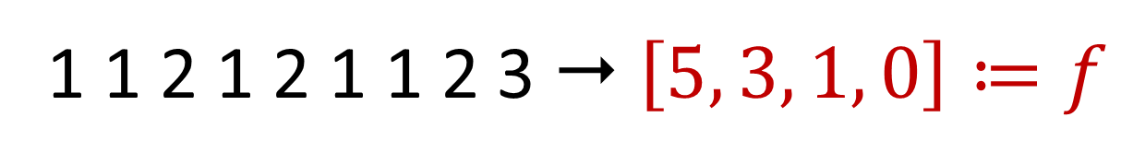

Heavy-Hitters
Given a set $S$ of $m$ elements from $[n]$, let $f_{i}$ be the frequency of element $i$. (How often it appears)
1 1 2 1 2 1 1 2 3  $\left[5, 3, 1, 0\right]≔f$

Slide 4
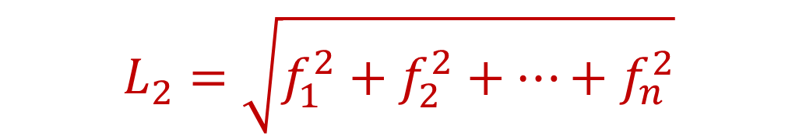
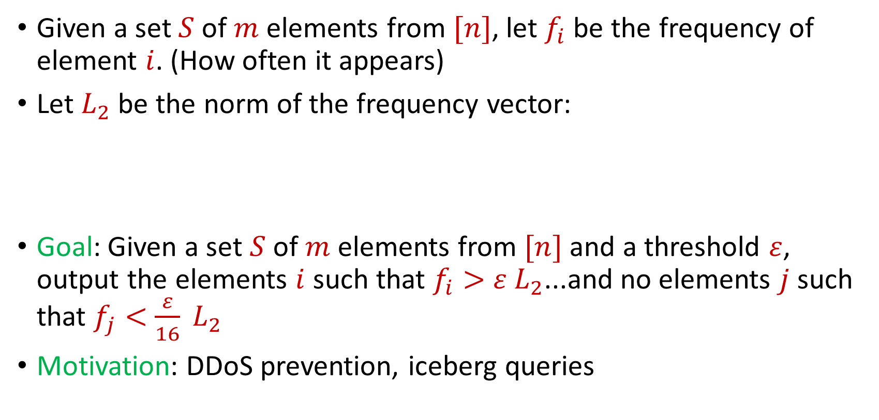
Heavy-Hitters
Given a set $S$ of $m$ elements from $[n]$, let $f_{i}$ be the frequency of element $i$. (How often it appears)
Let $L_{2}$ be the norm of the frequency vector:
Goal: Given a set $S$ of $m$ elements from $[n]$ and a threshold $ε$, output the elements $i$ such that $f_{i}>$ $ε L_{2}$...and no elements $j$ such that $f_{j}<$ $\frac{ε}{16} L_{2}$
Motivation: DDoS prevention, iceberg queries
$$L_{2}=\sqrt{f_{1}^{2}+f_{2}^{2}+…+f_{n}^{2}}$$

Slide 5
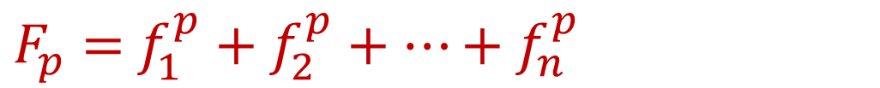
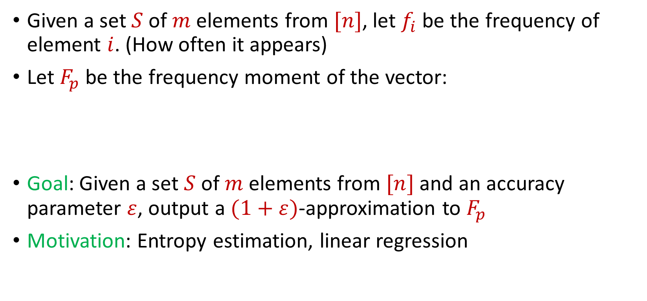
Frequency Moments
Given a set $S$ of $m$ elements from $[n]$, let $f_{i}$ be the frequency of element $i$. (How often it appears)
Let $F_{p}$ be the frequency moment of the vector:
Goal: Given a set $S$ of $m$ elements from $[n]$ and an accuracy parameter $ε$, output a $(1+ε)$-approximation to $F_{p}$
Motivation: Entropy estimation, linear regression
$F_{p}=$ $f_{1}^{p}+f_{2}^{p}+…+f_{n}^{p}$

Slide 6
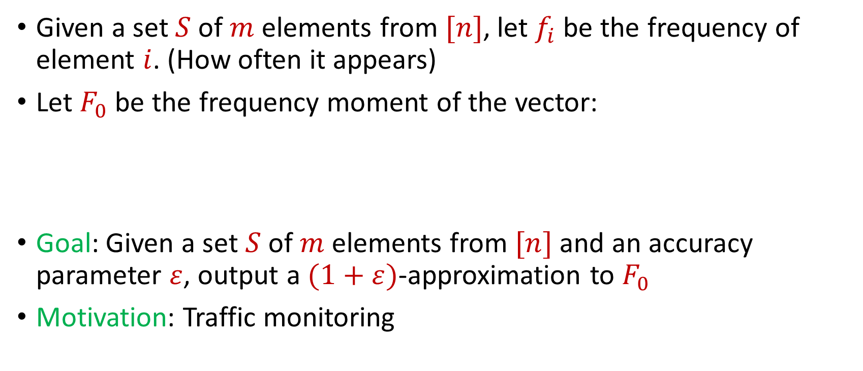
Distinct Elements
Given a set $S$ of $m$ elements from $[n]$, let $f_{i}$ be the frequency of element $i$. (How often it appears)
Let $F_{0}$ be the frequency moment of the vector:
Goal: Given a set $S$ of $m$ elements from $[n]$ and an accuracy parameter $ε$, output a $(1+ε)$-approximation to $F_{0}$
Motivation: Traffic monitoring
$F_{0}=$ $|\{i :f_{i}≠0\}|$

Slide 7
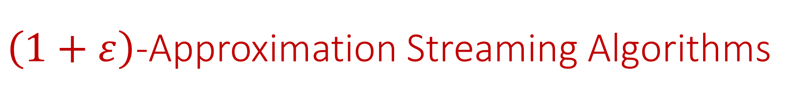
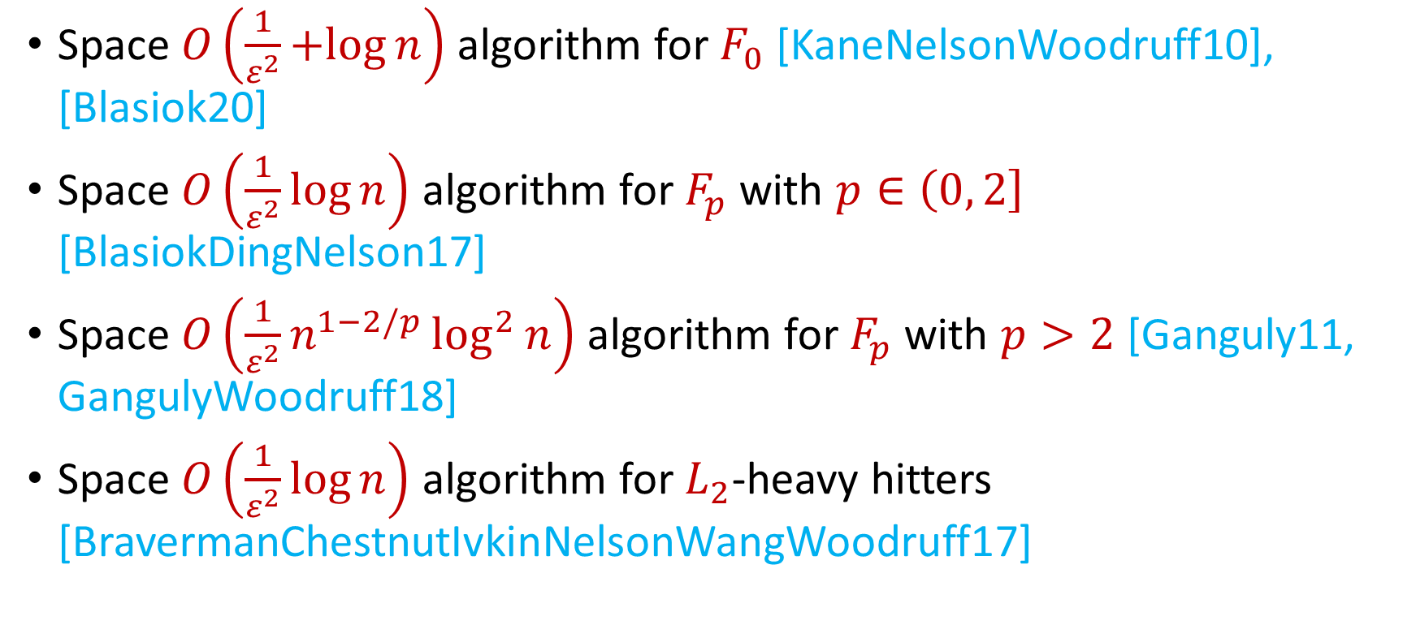
$\left(1+ε\right)$-Approximation Streaming Algorithms
Space $O\left(\frac{1}{ε^{2}}+log{n}\right)$ algorithm for $F_{0}$ [KaneNelsonWoodruff10], [Blasiok20]
Space $O\left(\frac{1}{ε^{2}}\log{n}\right)$ algorithm for $F_{p}$ with $p∈\left(0, 2\right]$ [BlasiokDingNelson17]
Space $O\left(\frac{1}{ε^{2}}n^{1−2/p}\log^{2}{n}\right)$ algorithm for $F_{p}$ with $p>2$ [Ganguly11, GangulyWoodruff18]
Space $O\left(\frac{1}{ε^{2}}\log{n}\right)$ algorithm for $L_{2}$-heavy hitters [BravermanChestnutIvkinNelsonWangWoodruff17]

Slide 8



Model #2: Adversarially Robust Streaming
Input: Elements of an underlying data set $S$, which arrives sequentially and adversarially
Output: Evaluation (or approximation) of a given function
Goal: Use space sublinear in the size $m$of the input $S$
1
1
Notes:
Let’s start by breaking down each of the terms in the title. To understand the sliding window model, we first have to understand the streaming model of computation, in which elements of an underlying data set S, arrive sequentially and the goal is to evaluate or approximate some given function on this dataset, using space sublinear in S. In the sliding window model, only the W most recent updates form the underlying data set

Slide 9
Model #2: Adversarially Robust Streaming
Input: Elements of an underlying data set $S$, which arrives sequentially and adversarially
Output: Evaluation (or approximation) of a given function
Goal: Use space sublinear in the size $m$of the input $S$
10
1
Notes:
Let’s start by breaking down each of the terms in the title. To understand the sliding window model, we first have to understand the streaming model of computation, in which elements of an underlying data set S, arrive sequentially and the goal is to evaluate or approximate some given function on this dataset, using space sublinear in S. In the sliding window model, only the W most recent updates form the underlying data set

Slide 10
Model #2: Adversarially Robust Streaming
Input: Elements of an underlying data set $S$, which arrives sequentially and adversarially
Output: Evaluation (or approximation) of a given function
Goal: Use space sublinear in the size $m$of the input $S$
101
2
Notes:
Let’s start by breaking down each of the terms in the title. To understand the sliding window model, we first have to understand the streaming model of computation, in which elements of an underlying data set S, arrive sequentially and the goal is to evaluate or approximate some given function on this dataset, using space sublinear in S. In the sliding window model, only the W most recent updates form the underlying data set

Slide 11
Model #2: Adversarially Robust Streaming
Input: Elements of an underlying data set $S$, which arrives sequentially and adversarially
Output: Evaluation (or approximation) of a given function
Goal: Use space sublinear in the size $m$of the input $S$
1010
3
Notes:
Let’s start by breaking down each of the terms in the title. To understand the sliding window model, we first have to understand the streaming model of computation, in which elements of an underlying data set S, arrive sequentially and the goal is to evaluate or approximate some given function on this dataset, using space sublinear in S. In the sliding window model, only the W most recent updates form the underlying data set

Slide 12

Model #2: Adversarially Robust Streaming
Input: Elements of an underlying data set $S$, which arrives sequentially and adversarially
Output: Evaluation (or approximation) of a given function
Goal: Use space sublinear in the size $m$of the input $S$
1010
3
Notes:
Let’s start by breaking down each of the terms in the title. To understand the sliding window model, we first have to understand the streaming model of computation, in which elements of an underlying data set S, arrive sequentially and the goal is to evaluate or approximate some given function on this dataset, using space sublinear in S. In the sliding window model, only the W most recent updates form the underlying data set

Slide 13
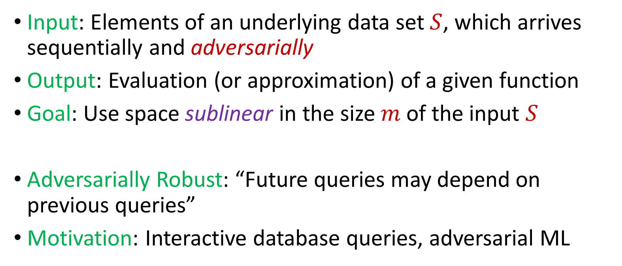
Model #2: Adversarially Robust Streaming
Input: Elements of an underlying data set $S$, which arrives sequentially and adversarially
Output: Evaluation (or approximation) of a given function
Goal: Use space sublinear in the size $m$of the input $S$
Adversarially Robust: “Future queries may depend on previous queries”
Motivation: Interactive database queries, adversarial ML
Notes:
Let’s start by breaking down each of the terms in the title. To understand the sliding window model, we first have to understand the streaming model of computation, in which elements of an underlying data set S, arrive sequentially and the goal is to evaluate or approximate some given function on this dataset, using space sublinear in S. In the sliding window model, only the W most recent updates form the underlying data set

Slide 14
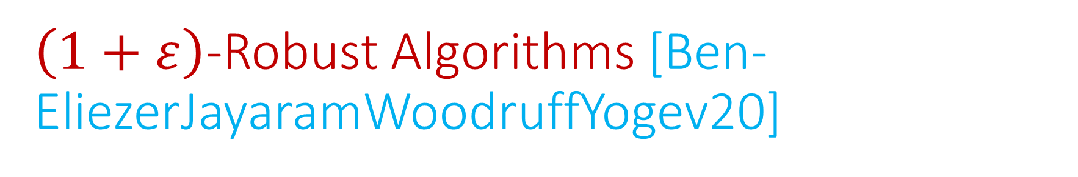
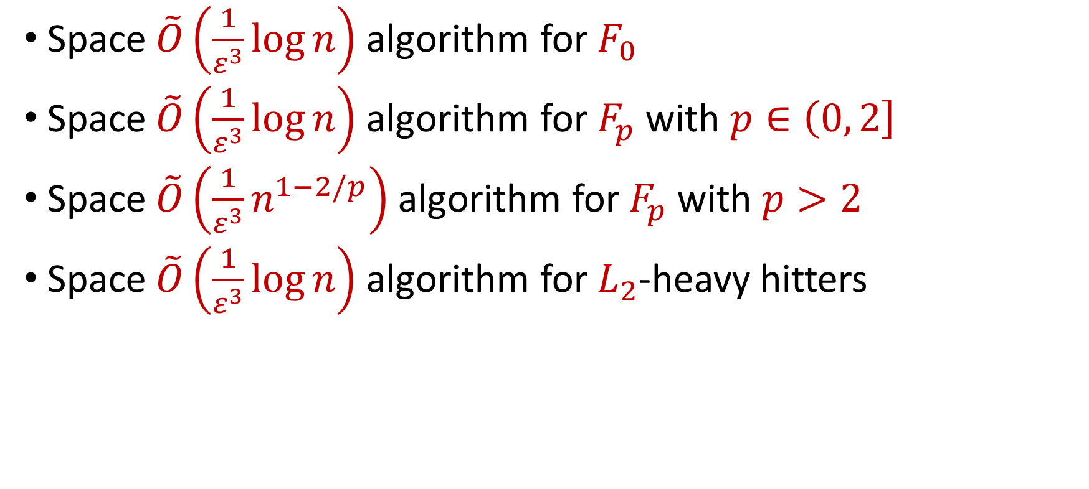
$\left(1+ε\right)$-Robust Algorithms [Ben-EliezerJayaramWoodruffYogev20]
Space $\tilde{O}\left(\frac{1}{ε^{3}}\log{n}\right)$ algorithm for $F_{0}$
Space $\tilde{O}\left(\frac{1}{ε^{3}}\log{n}\right)$ algorithm for $F_{p}$ with $p∈\left(0, 2\right]$
Space $\tilde{O}\left(\frac{1}{ε^{3}}n^{1−2/p}\right)$ algorithm for $F_{p}$ with $p>2$
Space $\tilde{O}\left(\frac{1}{ε^{3}}\log{n}\right)$ algorithm for $L_{2}$-heavy hitters
“A general framework that loses* nothing in $n$ and only $\frac{1}{ε}$ ”

Slide 15
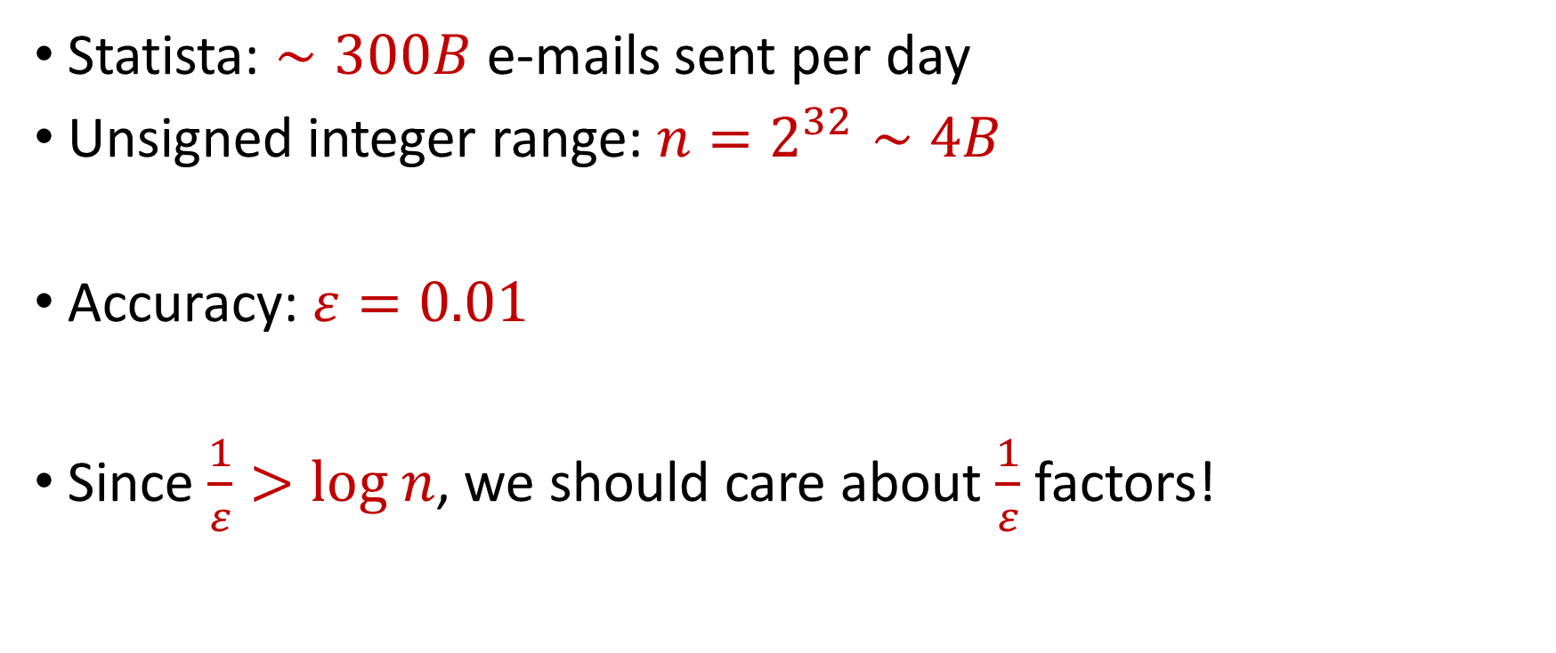
“What’s an epsilon between friends?
Statista: $∼300B$ e-mails sent per day
Unsigned integer range: $n=2^{32}∼4B$
Accuracy: $ε=0.01$
Since $\frac{1}{ε}>log n$, we should care about $\frac{1}{ε}$ factors!

Slide 16
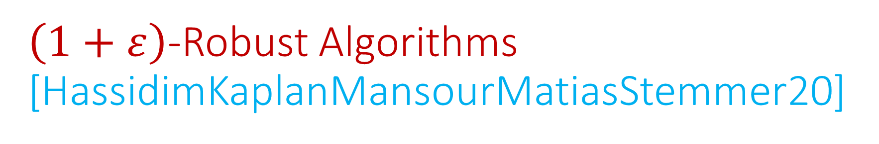
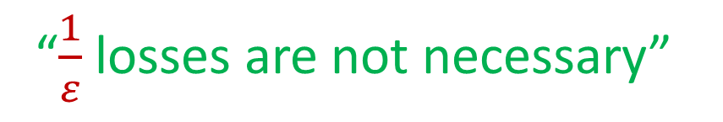
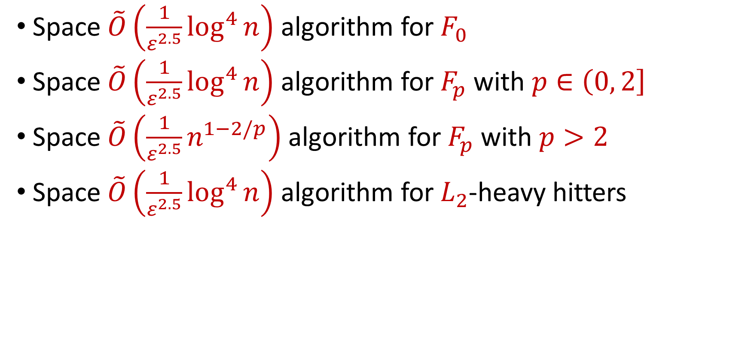
$\left(1+ε\right)$-Robust Algorithms [HassidimKaplanMansourMatiasStemmer20]
Space $\tilde{O}\left(\frac{1}{ε^{2.5}}\log^{4}{n}\right)$ algorithm for $F_{0}$
Space $\tilde{O}\left(\frac{1}{ε^{2.5}}\log^{4}{n}\right)$ algorithm for $F_{p}$ with $p∈\left(0, 2\right]$
Space $\tilde{O}\left(\frac{1}{ε^{2.5}}n^{1−2/p}\right)$ algorithm for $F_{p}$ with $p>2$
Space $\tilde{O}\left(\frac{1}{ε^{2.5}}\log^{4}{n}\right)$ algorithm for $L_{2}$-heavy hitters
“$\frac{1}{ε}$ losses are not necessary”

Slide 17

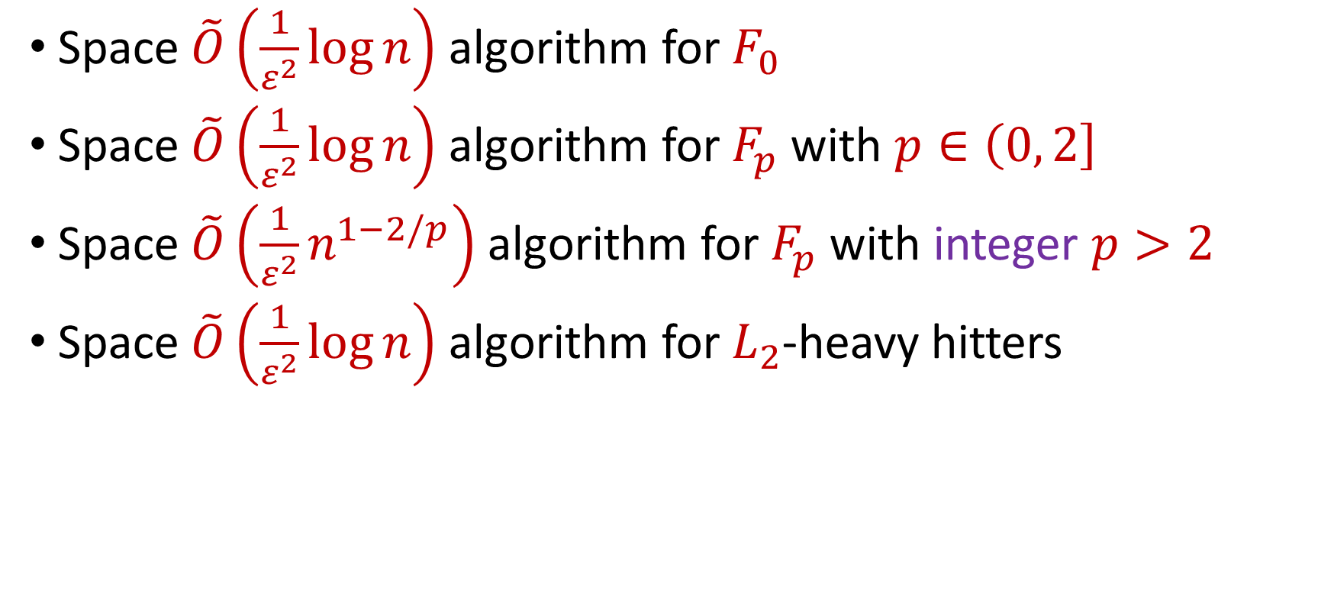
Our Results: $\left(1+ε\right)$-Robust Algorithms
Space $\tilde{O}\left(\frac{1}{ε^{2}}\log{n}\right)$ algorithm for $F_{0}$
Space $\tilde{O}\left(\frac{1}{ε^{2}}\log{n}\right)$ algorithm for $F_{p}$ with $p∈\left(0, 2\right]$
Space $\tilde{O}\left(\frac{1}{ε^{2}}n^{1−2/p}\right)$ algorithm for $F_{p}$ with integer $p>2$
Space $\tilde{O}\left(\frac{1}{ε^{2}}\log{n}\right)$ algorithm for $L_{2}$-heavy hitters
“No losses* are necessary!”

Slide 18
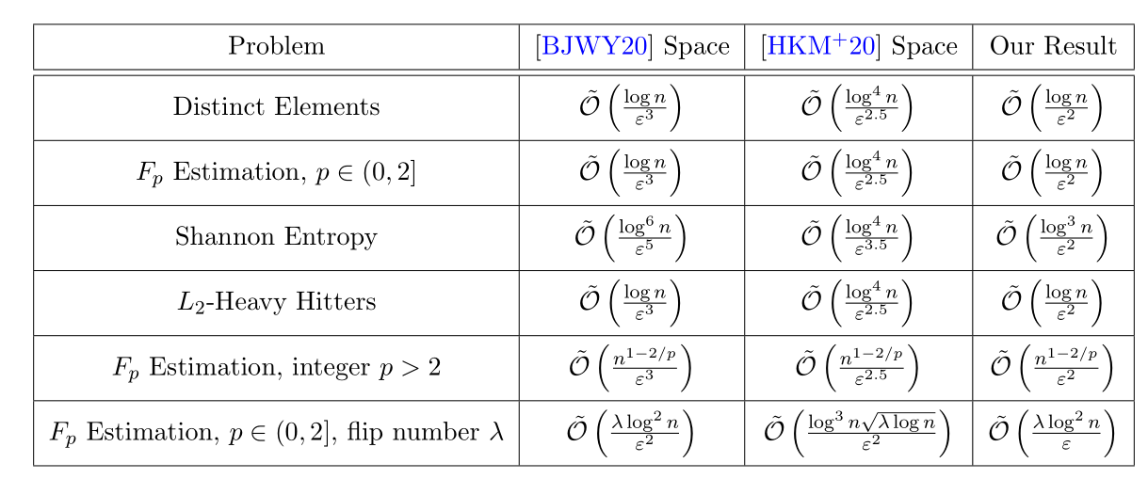

Summary: $\left(1+ε\right)$-Robust Algorithms

Slide 19
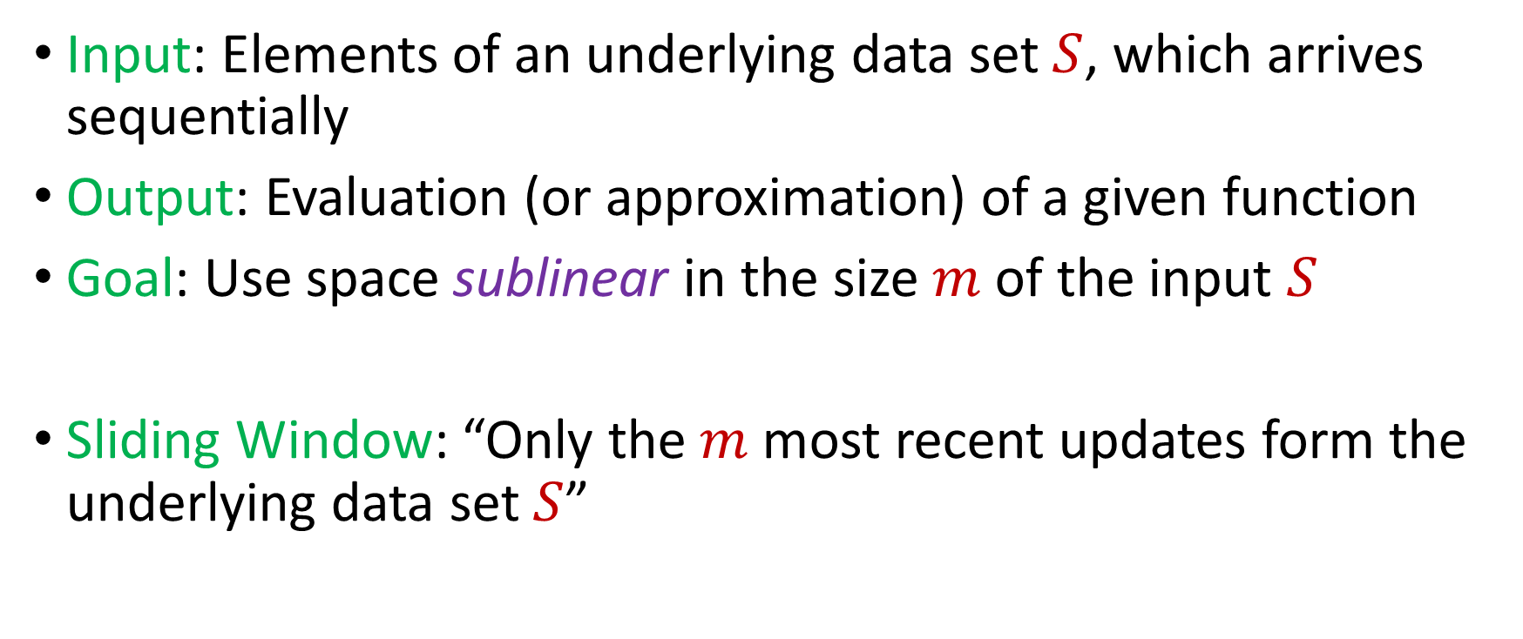
Model #3: Sliding Window Model
Input: Elements of an underlying data set $S$, which arrives sequentially
Output: Evaluation (or approximation) of a given function
Goal: Use space sublinear in the size $m$of the input $S$
Sliding Window: “Only the $m$ most recent updates form the underlying data set $S$”
1 0 1 1 1 0 0 1
Notes:
Let’s start by breaking down each of the terms in the title. To understand the sliding window model, we first have to understand the streaming model of computation, in which elements of an underlying data set S, arrive sequentially and the goal is to evaluate or approximate some given function on this dataset, using space sublinear in S. In the sliding window model, only the W most recent updates form the underlying data set

Slide 20
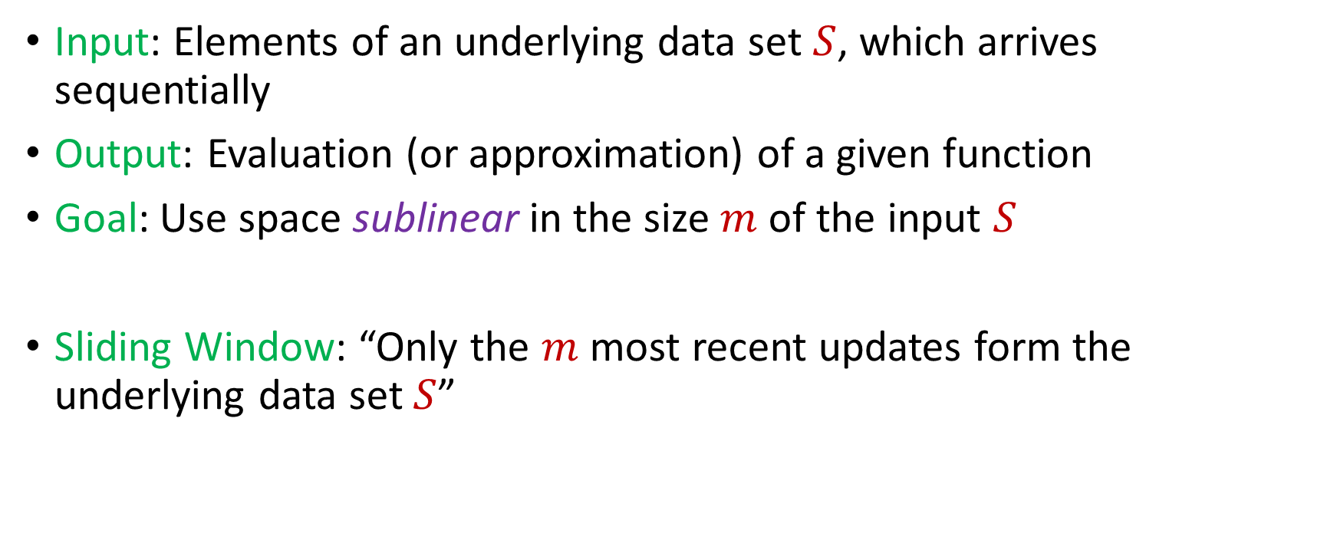
Model #3: Sliding Window Model
Input: Elements of an underlying data set $S$, which arrives sequentially
Output: Evaluation (or approximation) of a given function
Goal: Use space sublinear in the size $m$of the input $S$
Sliding Window: “Only the $m$ most recent updates form the underlying data set $S$”
1 0 1 1 1 0 0 1 1

Slide 21
Model #3: Sliding Window Model
Input: Elements of an underlying data set $S$, which arrives sequentially
Output: Evaluation (or approximation) of a given function
Goal: Use space sublinear in the size $m$of the input $S$
Sliding Window: “Only the $m$ most recent updates form the underlying data set $S$”
1 0 1 1 1 0 0 1 1 0

Slide 22

Model #3: Sliding Window Model
Input: Elements of an underlying data set $S$, which arrives sequentially
Output: Evaluation (or approximation) of a given function
Goal: Use space sublinear in the size $m$of the input $S$
Sliding Window: “Only the $m$ most recent updates form the underlying data set $S$”
Emphasizes recent interactions, appropriate for time sensitive settings
1 0 1 1 1 0 0 1 1 0 1
Notes:
The sliding window model emphasizes recent data and thus is appropriate for settings that are time sensitive.

Slide 23
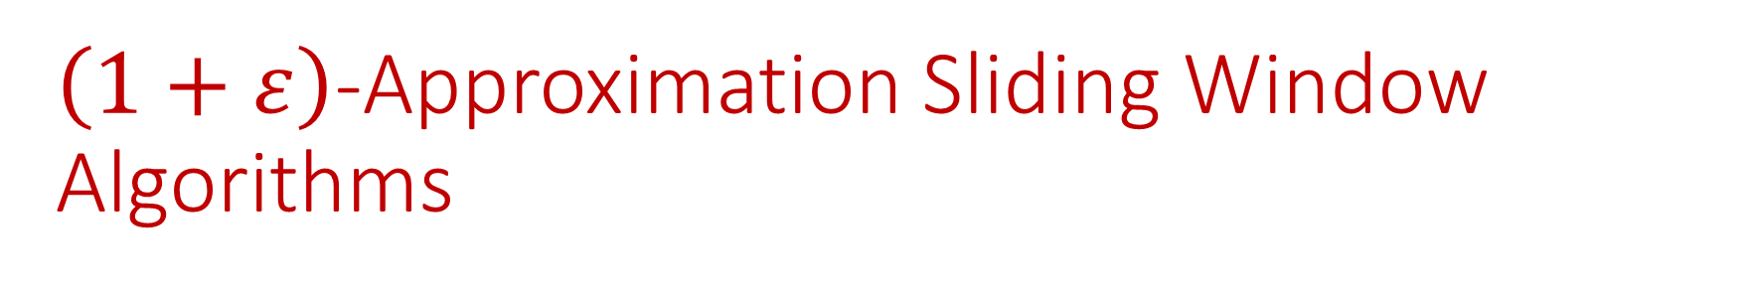
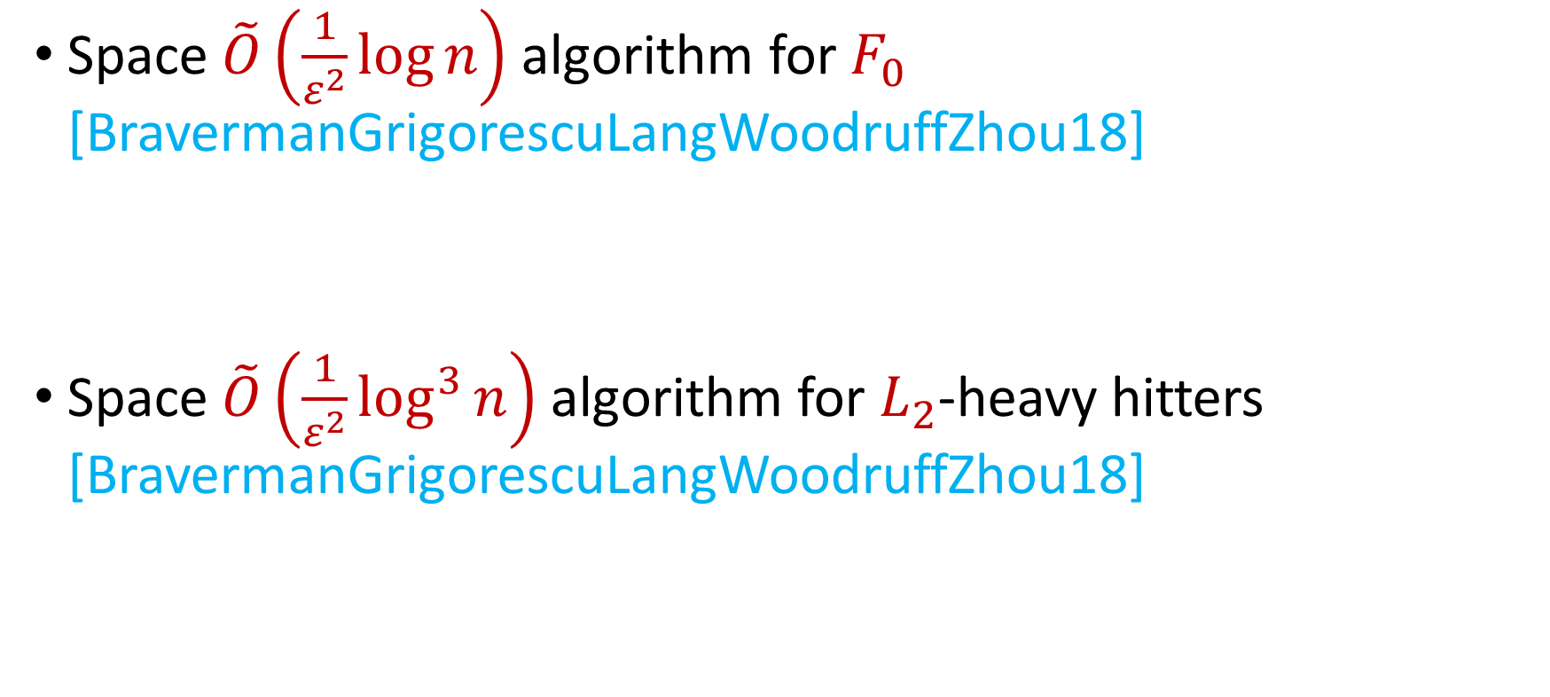
$\left(1+ε\right)$-Approximation Sliding Window Algorithms
Space $\tilde{O}\left(\frac{1}{ε^{2}}\log{n}\right)$ algorithm for $F_{0}$ [BravermanGrigorescuLangWoodruffZhou18]
Space $\tilde{O}\left(\frac{1}{ε^{2}}\log^{3}{n}\right)$algorithm for $L_{2}$-heavy hitters [BravermanGrigorescuLangWoodruffZhou18]

Slide 24
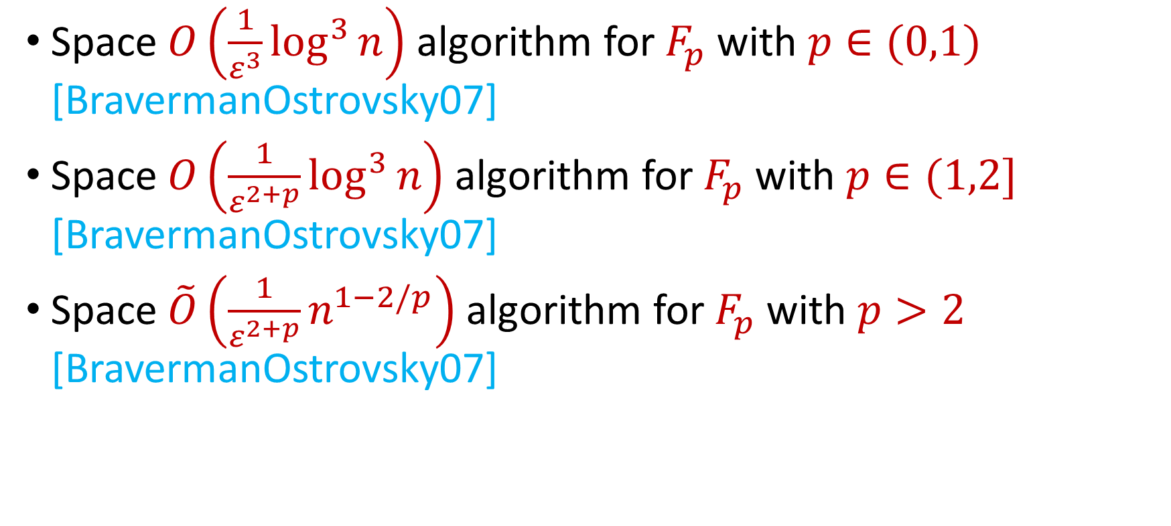
$\left(1+ε\right)$-Approximation Sliding Window Algorithms
Space $O\left(\frac{1}{ε^{3}}\log^{3}{n}\right)$ algorithm for $F_{p}$ with $p∈(0,1)$ [BravermanOstrovsky07]
Space $O\left(\frac{1}{ε^{2+p}}\log^{3}{n}\right)$ algorithm for $F_{p}$ with $p∈(1,2]$ [BravermanOstrovsky07]
Space $\tilde{O}\left(\frac{1}{ε^{2+p}}n^{1−2/p}\right)$ algorithm for $F_{p}$ with $p>2$ [BravermanOstrovsky07]
“A general framework that loses* nothing in $n$ and only $\frac{1}{ε}$ ”

Slide 25
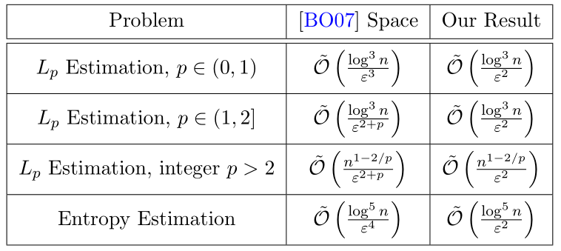

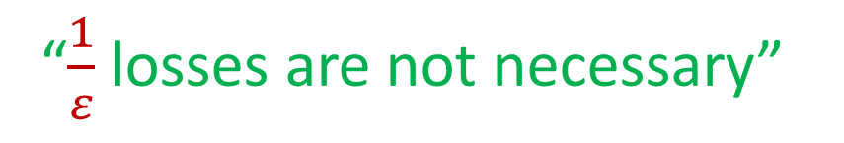

Our Results: $\left(1+ε\right)$-Approximation Sliding Window Algorithms
Space $\tilde{O}\left(\frac{1}{ε^{2}}\log^{3}{n}\right)$ algorithm for $F_{p}$ with $p∈\left(0, 2\right]$
“$\frac{1}{ε}$ losses are not necessary”

Slide 26
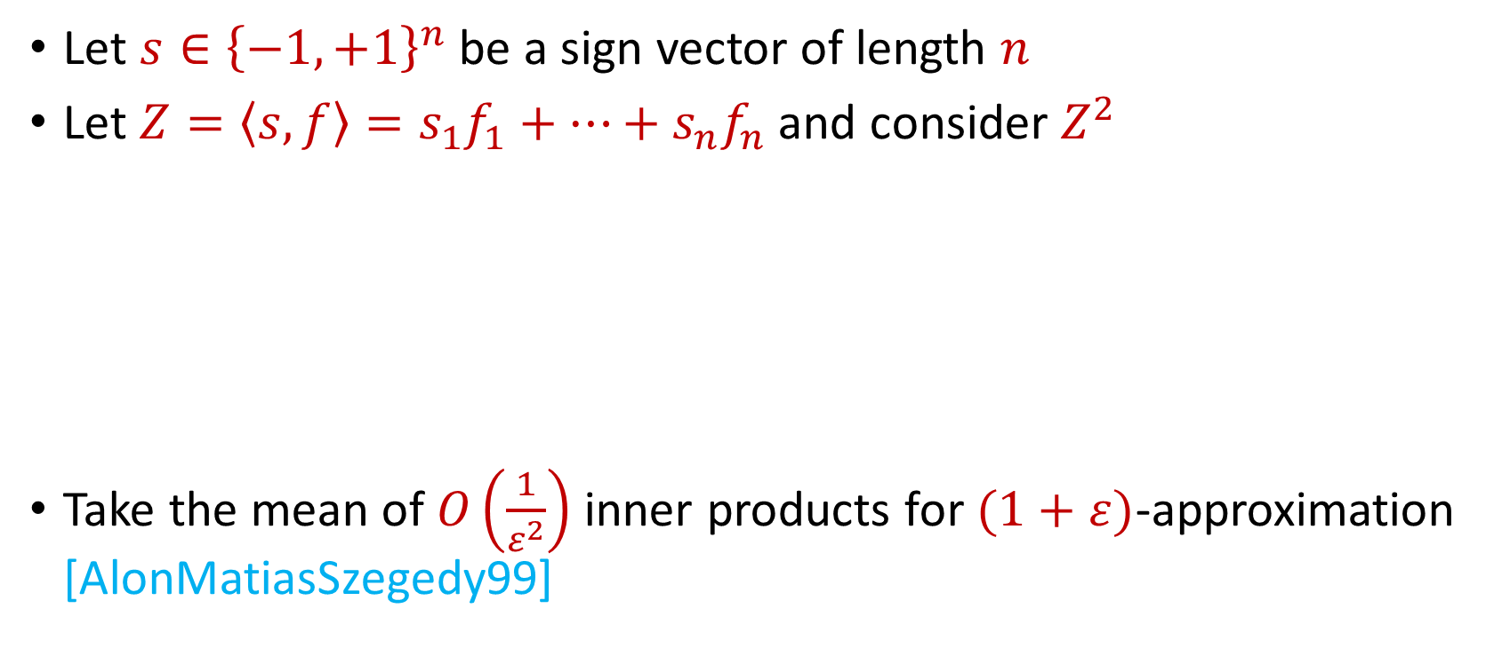

AMS $F_{2}$Algorithm
Let $s∈{\left\{−1,+1\right\}}^{n}$ be a sign vector of length $n$
Let $Z=\left\langle s,f\right\rangle =s_{1}f_{1}+…+s_{n}f_{n}$ and consider $Z^{2}$
Take the mean of $O\left(\frac{1}{ε^{2}}\right)$ inner products for $(1+ε)$-approximation [AlonMatiasSzegedy99]
$E\left[Z^{2}\right]=$ $\sum_{i,j}{E\left[s_{i}s_{j}f_{i}f_{j}\right]}=f_{1}^{2}+…+f_{n}^{2}$
$Var\left[Z^{2}\right]≤$ $\sum_{i,j}{E\left[s_{i}s_{j}s_{k}s_{l}f_{i}f_{j}f_{k}f_{l}\right]}≤2F_{2}^{2}$

Slide 27
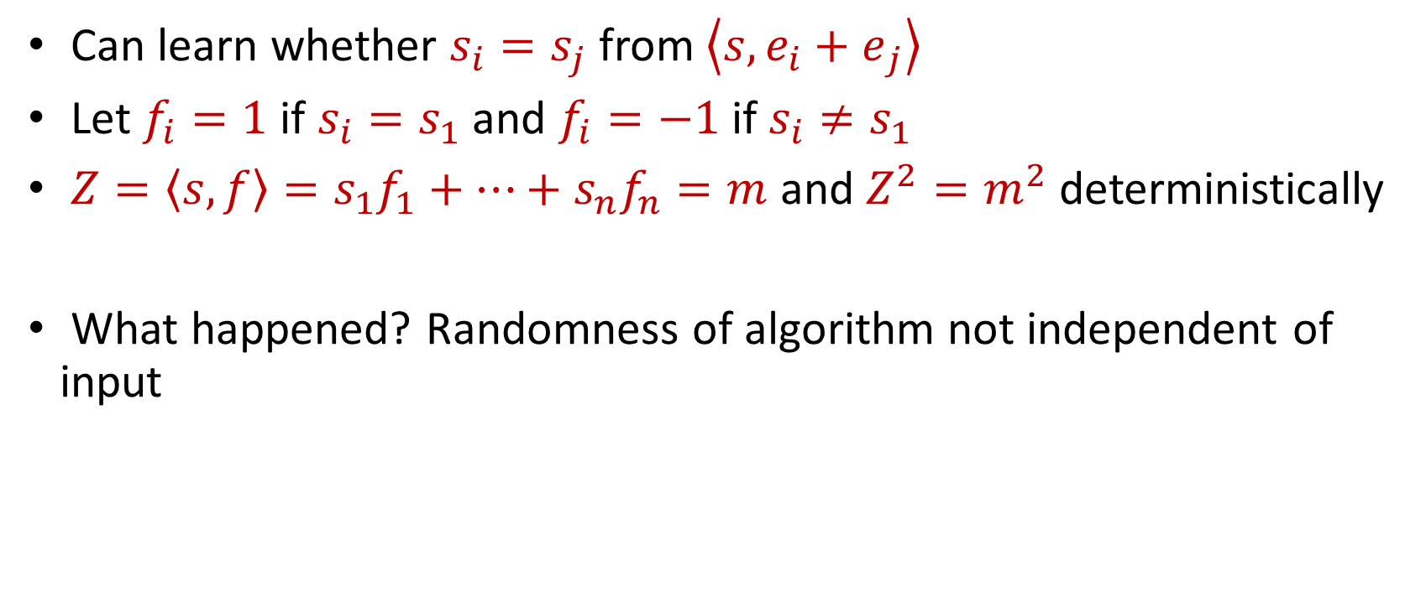
“Attack” on AMS
Can learn whether $s_{i}=s_{j}$ from $\left\langle s,{e_{i}+e}_{j}\right\rangle$
Let $f_{i}=1$ if $s_{i}=s_{1}$ and $f_{i}=−1$ if $s_{i}≠s_{1}$
$Z=\left\langle s,f\right\rangle =s_{1}f_{1}+…+s_{n}f_{n}=m$ and $Z^{2}=m^{2}$ deterministically
What happened? Randomness of algorithm not independent of input

Slide 28
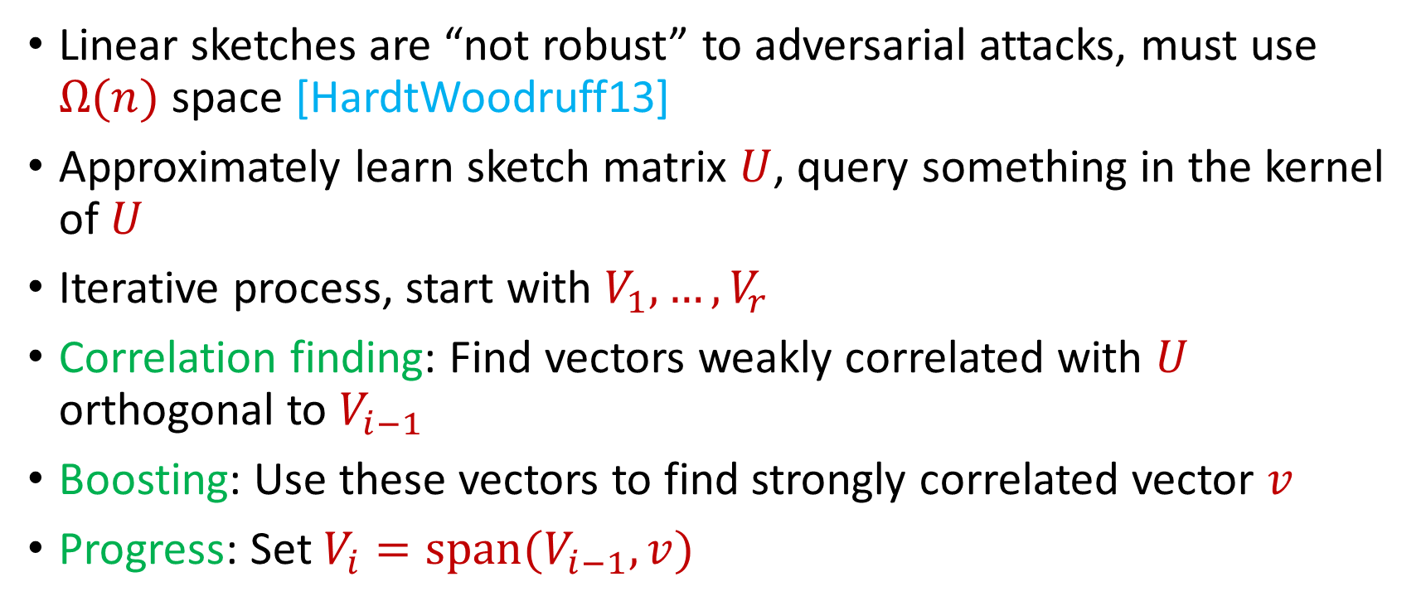
Reconstruction Attack on Linear Sketches
Linear sketches are “not robust” to adversarial attacks, must use $Ω(n)$ space [HardtWoodruff13]
Approximately learn sketch matrix $U$, query something in the kernel of $U$
Iterative process, start with $V_{1},…,V_{r}$
Correlation finding: Find vectors weakly correlated with $U$ orthogonal to $V_{i−1}$
Boosting: Use these vectors to find strongly correlated vector $v$
Progress: Set $V_{i}=span(V_{i−1},v)$

Slide 29
Insertion-Only Streams
Key: Deletions are needed to perform this attack
Similar lower bounds for the sliding window model [DatarGionisIndykMotwani02]
Assume insertion-only updates
How do the previous results work?

Slide 30
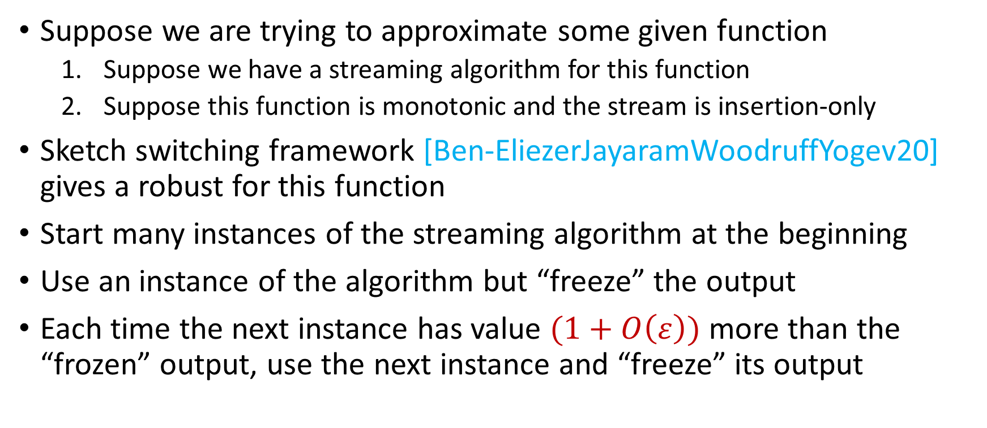
Robust Algorithms
Suppose we are trying to approximate some given function
Suppose we have a streaming algorithm for this function
Suppose this function is monotonic and the stream is insertion-only
Sketch switching framework [Ben-EliezerJayaramWoodruffYogev20] gives a robust for this function
Start many instances of the streaming algorithm at the beginning
Use an instance of the algorithm but “freeze” the output
Each time the next instance has value $(1+O\left(ε\right))$ more than the “frozen” output, use the next instance and “freeze” its output

Slide 31

Robust Algorithms
Start many instances of the streaming algorithm at the beginning
Use an instance of the algorithm but “freeze” the output
Each time the next instance has value $(1+O\left(ε\right))$ more than the “frozen” output, use the next instance and “freeze” its output
1
Example: Number of ones in the stream (2-approximation)
1
1
1
1

Slide 32

Robust Algorithms
Start many instances of the streaming algorithm at the beginning
Use an instance of the algorithm but “freeze” the output
Each time the next instance has value $(1+O\left(ε\right))$ more than the “frozen” output, use the next instance and “freeze” its output
1 0
Example: Number of ones in the stream (2-approximation)
1
1
1
1

Slide 33
Robust Algorithms
Start many instances of the streaming algorithm at the beginning
Use an instance of the algorithm but “freeze” the output
Each time the next instance has value $(1+O\left(ε\right))$ more than the “frozen” output, use the next instance and “freeze” its output
1 0 1
Example: Number of ones in the stream (2-approximation)
1
2
2
2

Slide 34
Robust Algorithms
Start many instances of the streaming algorithm at the beginning
Use an instance of the algorithm but “freeze” the output
Each time the next instance has value $(1+O\left(ε\right))$ more than the “frozen” output, use the next instance and “freeze” its output
1 0 1
Example: Number of ones in the stream (2-approximation)
1
2
2
2

Slide 35
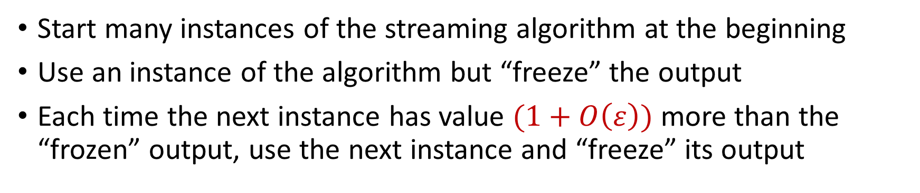
Robust Algorithms
Start many instances of the streaming algorithm at the beginning
Use an instance of the algorithm but “freeze” the output
Each time the next instance has value $(1+O\left(ε\right))$ more than the “frozen” output, use the next instance and “freeze” its output
1 0 1 1
Example: Number of ones in the stream (2-approximation)
1
2
3
3

Slide 36
Robust Algorithms
Start many instances of the streaming algorithm at the beginning
Use an instance of the algorithm but “freeze” the output
Each time the next instance has value $(1+O\left(ε\right))$ more than the “frozen” output, use the next instance and “freeze” its output
1 0 1 1 1
Example: Number of ones in the stream (2-approximation)
1
2
4
4

Slide 37
Robust Algorithms
Start many instances of the streaming algorithm at the beginning
Use an instance of the algorithm but “freeze” the output
Each time the next instance has value $(1+O\left(ε\right))$ more than the “frozen” output, use the next instance and “freeze” its output
1 0 1 1 1
Example: Number of ones in the stream (2-approximation)
1
2
4
4

Slide 38
Robust Algorithms
Start many instances of the streaming algorithm at the beginning
Use an instance of the algorithm but “freeze” the output
Each time the next instance has value $(1+O\left(ε\right))$ more than the “frozen” output, use the next instance and “freeze” its output
1 0 1 1 1 0 0 1 1 0 1
Example: Number of ones in the stream (2-approximation)
Number of ones stream is at least 4 and at most 8
4 is a good approximation
1
2
4
7

Slide 39

Summary
Sketch switching for robust algorithms uses $\frac{1}{ε^{2}}$ space each time $F_{p}$ increases by $(1+ε)$ and function increases $\frac{1}{ε}$ times

Slide 40


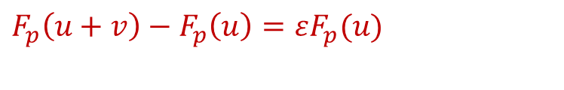





Intuition
Goal: $\tilde{Θ}\left(\frac{1}{ε^{2}}\right)$ space
Do we really need to pay $\frac{1}{ε^{2}}$ space each time $F_{p}$ increases by $(1+ε)$?
Only need constant factor approximation to $εF_{p}(u)$
Only need constant factor approximation to $F_{p}\left(u+v\right)−F_{p}\left(u\right)$
$F_{p}(u)$
$$u$$
$$u+v$$
$F_{p}\left(u+v\right)−F_{p}\left(u\right)=εF_{p}(u)$
$F_{p}(u+v)$
$$v$$

Slide 41







Sketch Stitching
Goal: $\tilde{Θ}\left(\frac{1}{ε^{2}}\right)$ space
Suppose we want $F_{p}\left(u+v\right)$
$F_{p}\left(u+v\right)={(F}_{p}\left(u+v\right)−F_{p}\left(u\right))+F_{p}(u)$
$F_{p}(u+v)$
$F_{p}(u)$
$$F_{p}\left(u+v\right)−F_{p}\left(u\right)$$
$$u$$
$$v$$
$$u+v$$

Slide 42





Sketch Stitching
Goal: $\tilde{Θ}\left(\frac{1}{ε^{2}}\right)$ space
Suppose we want $F_{p}\left(u+v\right)$ and $v=v_{1}+v_{2}+…+v_{b}$
$F_{p}(u+v)$
$F_{p}(u)$
$$F_{p}\left(u+v\right)−F_{p}\left(u\right)$$
$$u$$
$$v_{1}$$
$$v_{2}$$
$$v$$
$$u+v$$

Slide 43

Sketch Stitching
Goal: $\tilde{Θ}\left(\frac{1}{ε^{2}}\right)$ space
Suppose we want $F_{p}\left(u+v\right)$ and $v=v_{1}+v_{2}+…+v_{b}$
$F_{p}\left(u+v\right)={(F}_{p}\left(u+v\right)−F_{p}\left(u\right))+F_{p}(u)$
$F_{p}(u+v)$
$F_{p}(u)$
$$F_{p}\left(u+v\right)−F_{p}\left(u\right)$$
$$u$$
$$v_{1}$$
$$v_{2}$$
$$v$$
$$u+v$$

Slide 44
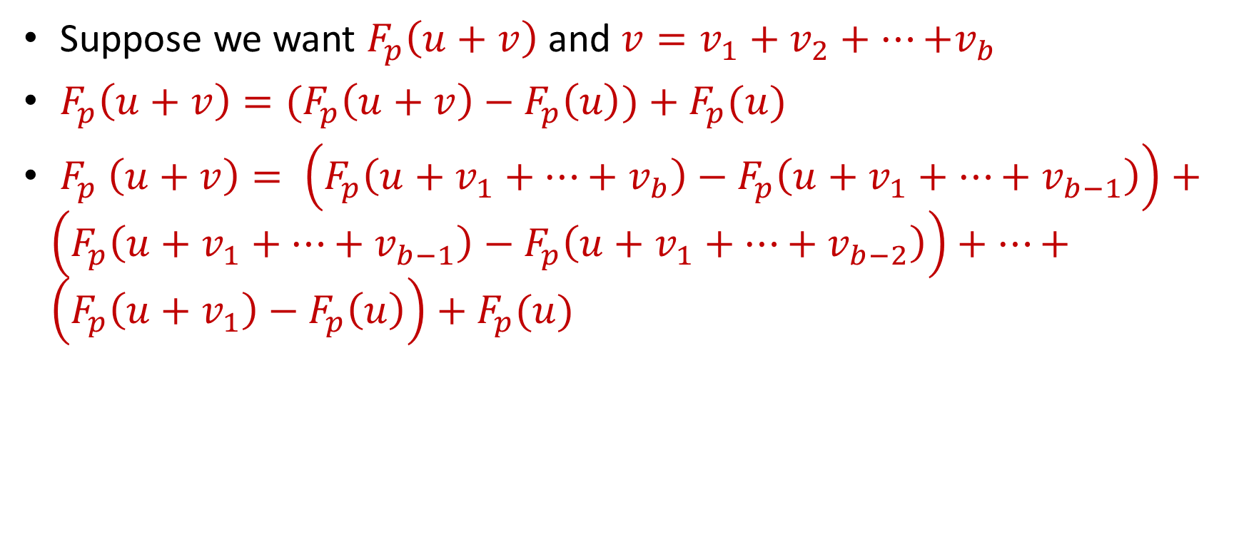
Sketch Stitching
Goal: $\tilde{Θ}\left(\frac{1}{ε^{2}}\right)$ space
Suppose we want $F_{p}\left(u+v\right)$ and $v=v_{1}+v_{2}+…{+v}_{b}$
$F_{p}\left(u+v\right)={(F}_{p}\left(u+v\right)−F_{p}\left(u\right))+F_{p}(u)$
$F_{p} \left(u+v\right)= \left(F_{p}\left(u+v_{1}+…+v_{b}\right)−F_{p}\left(u+v_{1}+…+v_{b−1}\right)\right)+\left(F_{p}\left(u+v_{1}+…+v_{b−1}\right)−F_{p}\left(u+v_{1}+…+v_{b−2}\right)\right)+…+\left(F_{p}\left(u+v_{1}\right)−F_{p}\left(u\right)\right)$ $+ F_{p}(u)$

Slide 45
Sketch Stitching
Goal: $\tilde{Θ}\left(\frac{1}{ε^{2}}\right)$ space
Suppose we want $F_{p}\left(u+v\right)$ and $v=v_{1}+v_{2}+…{+v}_{b}$
$F_{p}\left(u+v\right)={(F}_{p}\left(u+v\right)−F_{p}\left(u\right))+F_{p}(u)$
$F_{p} \left(u+v\right)= \left(F_{p}\left(u+v_{1}+…+v_{b}\right)−F_{p}\left(u+v_{1}+…+v_{b−1}\right)\right)+\left(F_{p}\left(u+v_{1}+…+v_{b−1}\right)−F_{p}\left(u+v_{1}+…+v_{b−2}\right)\right)+…+\left(F_{p}\left(u+v_{1}\right)−F_{p}\left(u\right)\right)$ $+ F_{p}(u)$

Slide 46
Sketch Stitching
Goal: $\tilde{Θ}\left(\frac{1}{ε^{2}}\right)$ space
Suppose we want $F_{p}\left(u+v\right)$ and $v=v_{1}+v_{2}+…{+v}_{b}$
$F_{p}\left(u+v\right)={(F}_{p}\left(u+v\right)−F_{p}\left(u\right))+F_{p}(u)$
$F_{p} \left(u+v\right)= \left(F_{p}\left(u+v_{1}+…+v_{b}\right)−F_{p}\left(u+v_{1}+…+v_{b−1}\right)\right)+\left(F_{p}\left(u+v_{1}+…+v_{b−1}\right)−F_{p}\left(u+v_{1}+…+v_{b−2}\right)\right)+…+\left(F_{p}\left(u+v_{1}\right)−F_{p}\left(u\right)\right)$ $+ F_{p}(u)$

Slide 47


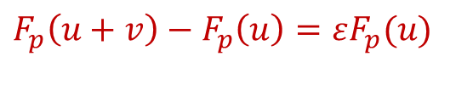



Sketch Stitching
Goal: $\tilde{Θ}\left(\frac{1}{ε^{2}}\right)$ space
Suppose we want $F_{p}\left(u+v\right)$ and $v=v_{1}+v_{2}+…{+v}_{b}$
$F_{p}\left(u+v\right)={(F}_{p}\left(u+v\right)−F_{p}\left(u\right))+F_{p}(u)$
$F_{p} \left(u+v\right)= \left(F_{p}\left(u+v_{1}+…+v_{b}\right)−F_{p}\left(u+v_{1}+…+v_{b−1}\right)\right)+\left(F_{p}\left(u+v_{1}+…+v_{b−1}\right)−F_{p}\left(u+v_{1}+…+v_{b−2}\right)\right)+…+\left(F_{p}\left(u+v_{1}\right)−F_{p}\left(u\right)\right)$ $+ F_{p}(u)$
$F_{p}(u)$
$$u$$
$$u+v$$
$F_{p}\left(u+v\right)−F_{p}\left(u\right)=εF_{p}(u)$
$F_{p}(u+v)$
$$v$$

Slide 48
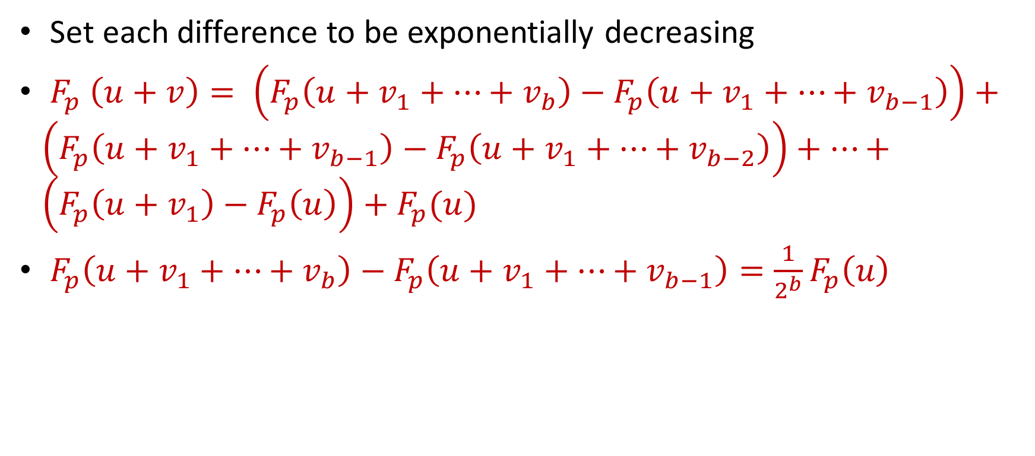
Granularity Change
Goal: $\tilde{Θ}\left(\frac{1}{ε^{2}}\right)$ space
Set each difference to be exponentially decreasing
$F_{p} \left(u+v\right)= \left(F_{p}\left(u+v_{1}+…+v_{b}\right)−F_{p}\left(u+v_{1}+…+v_{b−1}\right)\right)+\left(F_{p}\left(u+v_{1}+…+v_{b−1}\right)−F_{p}\left(u+v_{1}+…+v_{b−2}\right)\right)+…+\left(F_{p}\left(u+v_{1}\right)−F_{p}\left(u\right)\right)+F_{p}(u)$
$F_{p}\left(u+v_{1}+…+v_{b}\right)−F_{p}\left(u+v_{1}+…+v_{b−1}\right)=\frac{1}{2^{b}}F_{p}\left(u\right)$

Slide 49

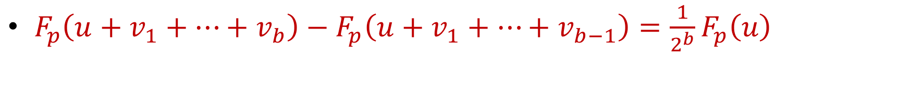



Granularity Change
Goal: $\tilde{Θ}\left(\frac{1}{ε^{2}}\right)$ space
$F_{p}\left(u+v_{1}+…+v_{b}\right)−F_{p}\left(u+v_{1}+…+v_{b−1}\right)=\frac{1}{2^{b}}F_{p}\left(u\right)$
$F_{p}(u+v)$
$F_{p}(u)$
$$F_{p}\left(u+v\right)−F_{p}\left(u\right)$$
$$u$$
$$u+v$$
$$v_{1}$$
$$v$$
$$v_{2}$$
Previously:

Slide 50
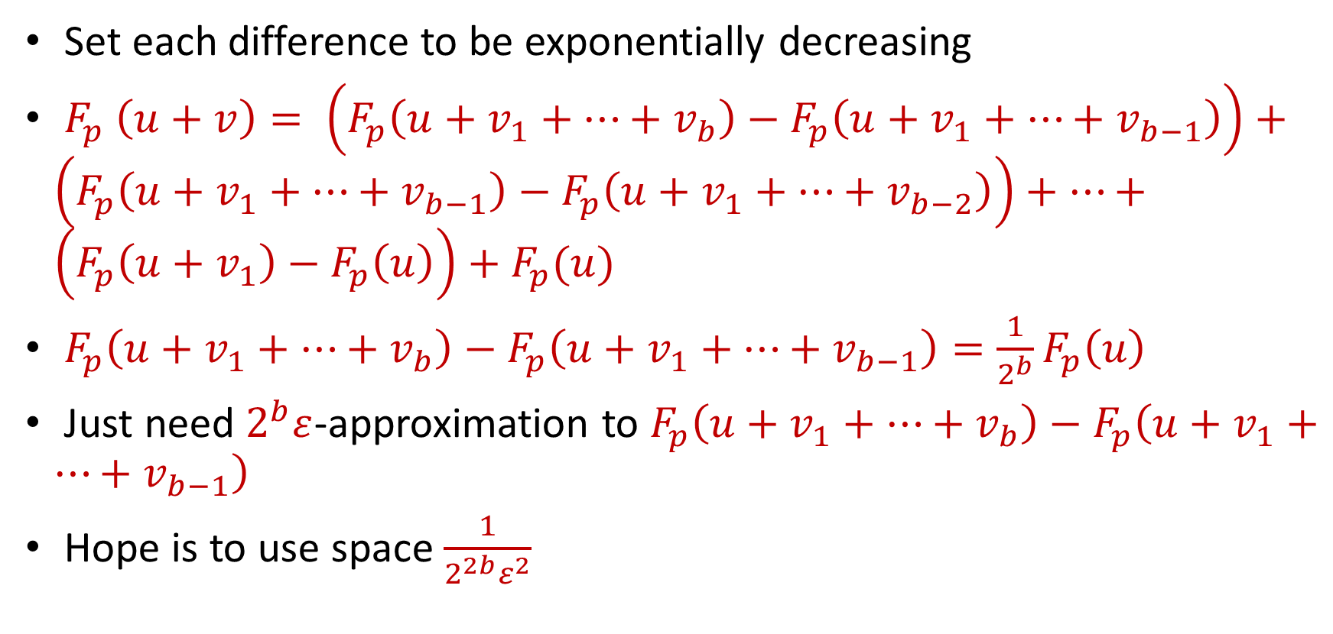
Granularity Change
Goal: $\tilde{Θ}\left(\frac{1}{ε^{2}}\right)$ space
Set each difference to be exponentially decreasing
$F_{p} \left(u+v\right)= \left(F_{p}\left(u+v_{1}+…+v_{b}\right)−F_{p}\left(u+v_{1}+…+v_{b−1}\right)\right)+\left(F_{p}\left(u+v_{1}+…+v_{b−1}\right)−F_{p}\left(u+v_{1}+…+v_{b−2}\right)\right)+…+\left(F_{p}\left(u+v_{1}\right)−F_{p}\left(u\right)\right)+F_{p}(u)$
$F_{p}\left(u+v_{1}+…+v_{b}\right)−F_{p}\left(u+v_{1}+…+v_{b−1}\right)=\frac{1}{2^{b}}F_{p}\left(u\right)$
Just need $2^{b}ε$-approximation to $F_{p}\left(u+v_{1}+…+v_{b}\right)−F_{p}\left(u+v_{1}+…+v_{b−1}\right)$
Hope is to use space $\frac{1}{{2^{2b}ε}^{2}}$

Slide 51


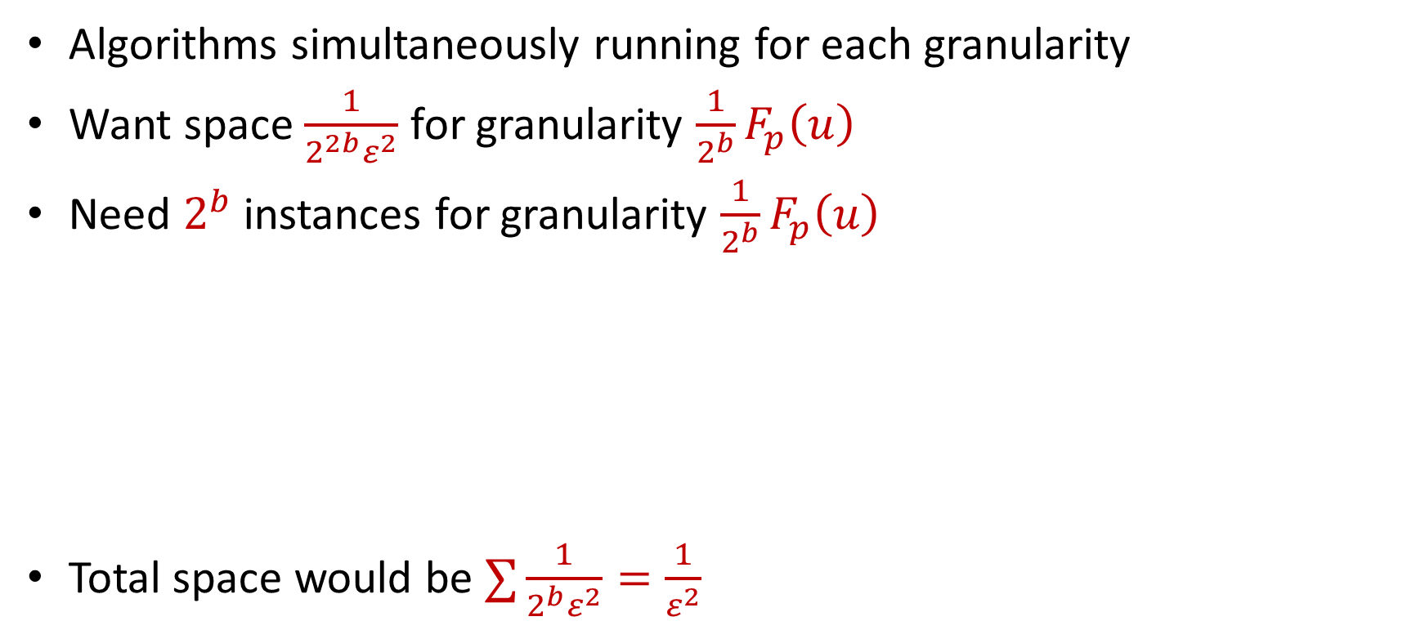



Framework
Goal: $\tilde{Θ}\left(\frac{1}{ε^{2}}\right)$ space
Algorithms simultaneously running for each granularity
Want space $\frac{1}{{2^{2b}ε}^{2}}$ for granularity $\frac{1}{2^{b}}F_{p}\left(u\right)$
Need $2^{b}$ instances for granularity $\frac{1}{2^{b}}F_{p}\left(u\right)$
Total space would be $∑\frac{1}{{2^{b}ε}^{2}}=\frac{1}{ε^{2}}$
$$u$$
$$v_{1}$$
$$u$$
$$v_{1}$$
$$v_{2}$$

Slide 52

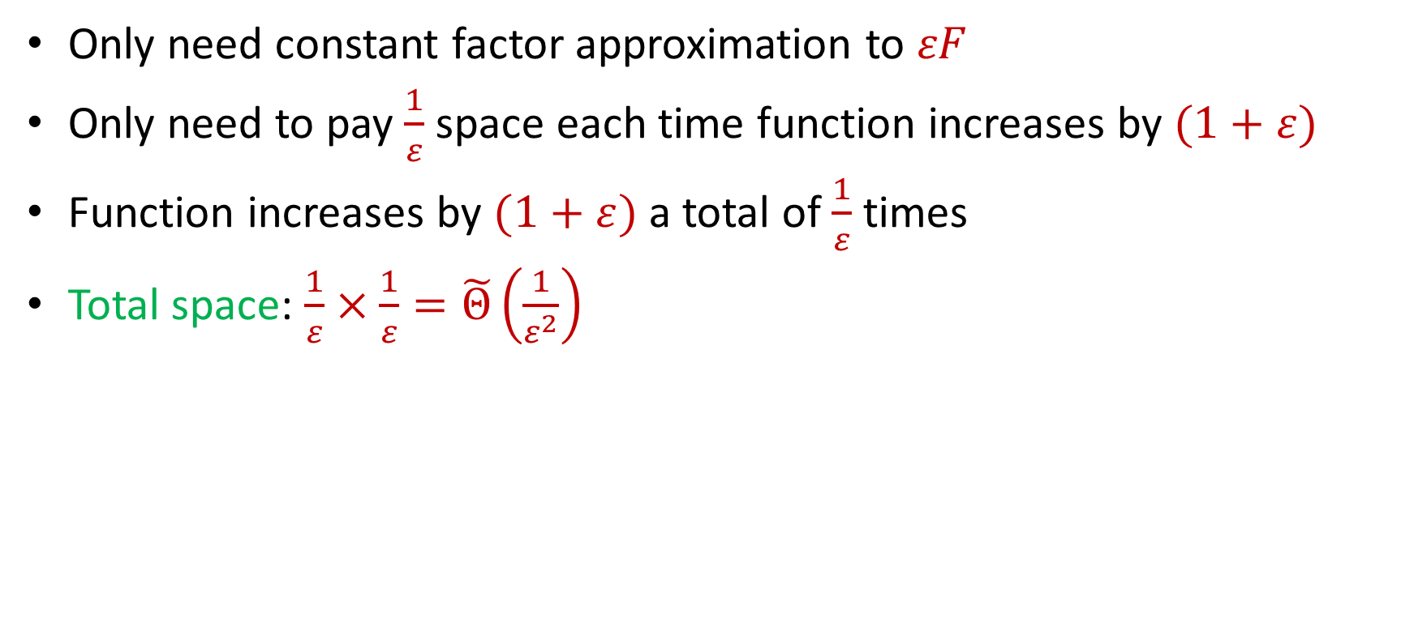

Summary
Goal: $\tilde{Θ}\left(\frac{1}{ε^{2}}\right)$ space
Only need constant factor approximation to $εF$
Only need to pay $\frac{1}{ε}$ space each time function increases by $(1+ε)$
Function increases by $(1+ε)$ a total of $\frac{1}{ε}$ times
Total space: $\frac{1}{ε}×\frac{1}{ε}=\tilde{Θ}\left(\frac{1}{ε^{2}}\right)$
$$F$$
$$εF$$

Slide 53


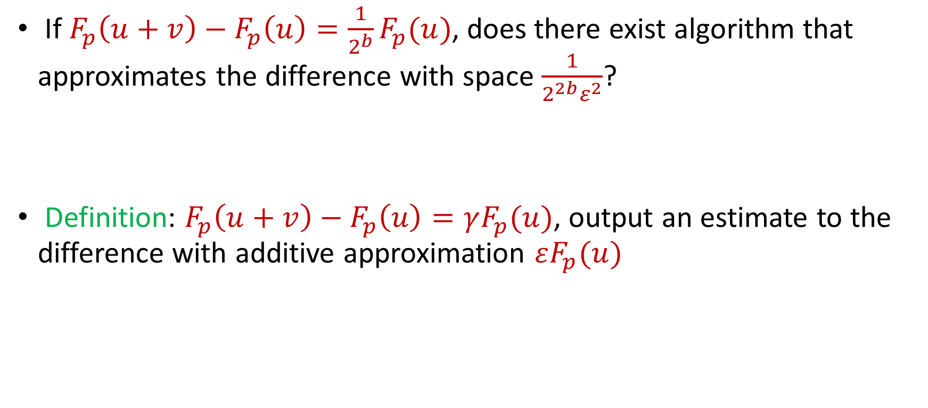
Difference Estimator
If $F_{p}\left(u+v\right)−F_{p}\left(u\right)=\frac{1}{2^{b}}F_{p}(u)$, does there exist algorithm that approximates the difference with space $\frac{1}{{2^{2b}ε}^{2}}$?
Definition: $F_{p}\left(u+v\right)−F_{p}\left(u\right)=γF_{p}(u)$, output an estimate to the difference with additive approximation $εF_{p}(u)$

Slide 54
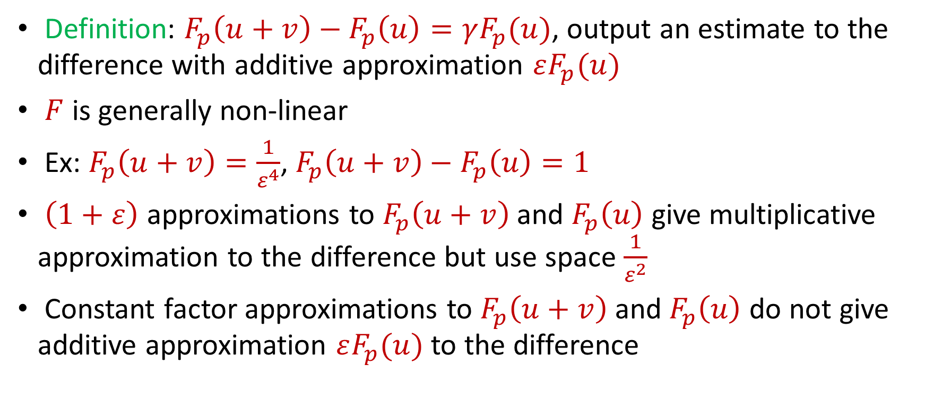
Difference Estimator
Definition: $F_{p}\left(u+v\right)−F_{p}\left(u\right)=γF_{p}(u)$, output an estimate to the difference with additive approximation $εF_{p}(u)$
$F$ is generally non-linear
Ex: $F_{p}\left(u+v\right)=\frac{1}{ε^{4}}$, $F_{p}\left(u+v\right)−F_{p}\left(u\right)=1$
$\left(1+ε\right)$ approximations to $F_{p}\left(u+v\right)$ and $F_{p}\left(u\right)$ give multiplicative approximation to the difference but use space $\frac{1}{ε^{2}}$
Constant factor approximations to $F_{p}\left(u+v\right)$ and $F_{p}\left(u\right)$ do not give additive approximation $εF_{p}(u)$ to the difference

Slide 55
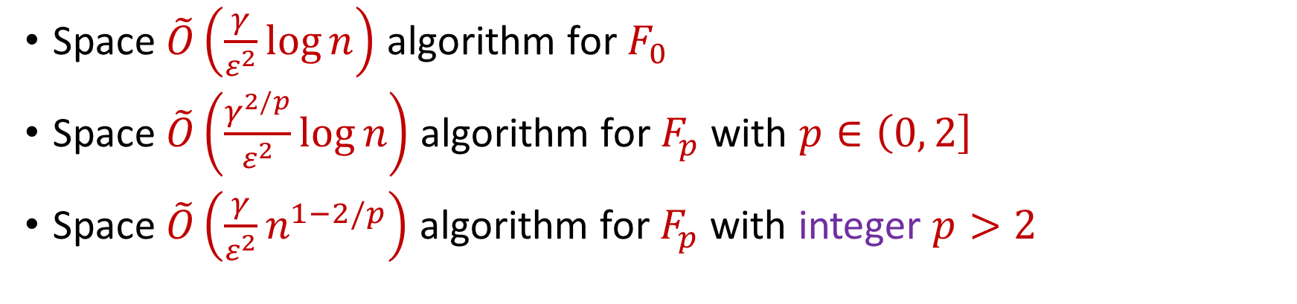
Our Results: Difference Estimators
Space $\tilde{O}\left(\frac{γ}{ε^{2}}\log{n}\right)$ algorithm for $F_{0}$
Space $\tilde{O}\left(\frac{γ^{2/p}}{ε^{2}}\log{n}\right)$ algorithm for $F_{p}$ with $p∈\left(0, 2\right]$
Space $\tilde{O}\left(\frac{γ}{ε^{2}}n^{1−2/p}\right)$ algorithm for $F_{p}$ with integer $p>2$

Slide 56


$F_{2}$ Difference Estimator
Definition: $F_{2}\left(u+v\right)−F_{2}\left(u\right)=γF_{2}(u)$, output an estimate to the difference with additive approximation $εF_{2}(u)$
$F_{2}\left(u+v\right)−F_{2}\left(u\right)=\left\langle u+v,u+v\right\rangle −\left\langle u,u\right\rangle =2\left\langle u,v\right\rangle +{\left\langle v,v\right\rangle }^{2}$

Slide 57

$F_{2}$ Difference Estimator
Inner product property: $\left(1+ε\right)$-approximations to ${\left\|u\right\|}_{2}$ and ${\left\|v\right\|}_{2}$ gives an ${ε\left\|u\right\|}_{2}{\left\|v\right\|}_{2}$ additive approximation to $\left\langle u,v\right\rangle$
$γF_{2}\left(u\right)={\left\langle v,v\right\rangle }^{2}$ implies $2\left\langle u,v\right\rangle ≤2{\left\|u\right\|}_{2}{\left\|v\right\|}_{2}=2\sqrt{γ}$ $F_{2}\left(u\right)$
Just need $\frac{ε}{\sqrt{γ}}$ multiplicative approximation: $\tilde{O}\left(\frac{γ}{ε^{2}}\log{n}\right)$ space!

Slide 58


$F_{2}$ Difference Estimator
Difference estimator: Maintain $\left(1+\frac{ε}{\sqrt{γ}}\right)$-approximations to $F_{2}\left(u+v\right)$ and $F_{2}\left(u\right)$ using AMS sketch
For $F_{2}\left(u+v\right)−F_{2}\left(u\right)=γF_{2}(u)$, difference of the outputs is an additive approximation $εF_{2}(u)$ to $F_{2}\left(u+v\right)−F_{2}\left(u\right)$

Slide 59



Challenges for Difference Estimators
$F_{p}$ difference estimator: Use $p$-stable random variables for $p≤2$?
How to use approach of [BlasiokDingNelson17]?
$\left\langle Z_{p},f\right\rangle$ where $Z_{p}$ has entries drawn from $p$-stable distribution
$$p\left(x\right)∼\frac{1}{1+{\left|x\right|}^{p+1}}$$

Slide 60

Challenges for Difference Estimators
$Z=median\left\langle Z_{p},f\right\rangle$
How to analyze median of each estimate of $F_{p}\left(u+v\right)−F_{p}\left(u\right)$?
Use Li’s geometric mean algorithm [Li08]
Take the geometric mean of 3 inner products $\left\langle Z_{p},f\right\rangle$
Take the average of $O\left(\frac{1}{ε^{2}}\right)$ geometric means

Slide 61

Challenges for Difference Estimators
Difference estimator: Maintain $\left(1+\frac{ε}{γ^{1/p}}\right)$-approximations to $F_{p}\left(u+v\right)$ and $F_{p}\left(u\right)$ using Li’s geometric mean estimator
$A\left(u+v\right)−A\left(u\right)∼{\left\langle p_{1},v\right\rangle }^{p/3}{\left\langle p_{2},v\right\rangle }^{p/3}$ ${\left\langle p_{3},v\right\rangle }^{p/3}+$
Each summand has ${\left\langle p_{1},v\right\rangle }^{p/3}$ term, which has much smaller variance
${\left\langle p_{1},u\right\rangle }^{p/3}{\left\langle p_{2},v\right\rangle }^{p/3}$ ${\left\langle p_{1},v\right\rangle }^{p/3}+$
${\left\langle p_{1},u\right\rangle }^{p/3}{\left\langle p_{2},u\right\rangle }^{p/3}$ ${\left\langle p_{1},v\right\rangle }^{p/3}+…$

Slide 62

Challenges for Difference Estimators
$F_{p}$ difference estimator: Generalization of inner products for $p>2$?
Variance can be much larger!
Use heavy-hitter algorithm to explicitly track “heavy” elements
Use $L_{2}$ sampling algorithm with $n^{1−2/p}$ buckets to sample “light” elements

Slide 63

Challenges for Difference Estimators
Use known structural results from chaining to remove $\log{n}$ factor in difference estimator
Avoids typical Chernoff + union bound argument by considering the expected supremum of a process, “strong tracking”
Use suffix argument to remove $\log{n}$ factor in framework
Adaptation to sliding window model

Slide 64
New Framework for Streaming Algorithms
Sketch Stitching
Granularity Change
Difference Estimators

Slide 65


Sliding Window Algorithms
Suppose we are trying to approximate some given function
Suppose we have a streaming algorithm for this function
Suppose this function is “smooth”: If $f\left(B\right)$ is a “good” approximation to $f\left(A\right)$, then $f\left(B∪C\right)$ will always be a “good” approximation to $f\left(A∪C\right)$.
Smooth histogram framework [BravermanOstrovsky07] gives a sliding window algorithm for this function

Slide 66
Smooth Histogram
Suppose we are trying to approximate some given function
Smooth histogram framework [BO07] gives a sliding window algorithm for this function
Start a new instance of the streaming algorithm (along with existing instances) each time a new element arrives
Each time there are three instances that report “close” values, delete the middle one
Use different checkpoints to “sandwich” the sliding window

Slide 67
Smooth Histogram
Start a new instance of the streaming algorithm (along with existing instances) each time a new element arrives
Each time there are three instances that report “close” values, delete the middle one
Use different checkpoints to “sandwich” the sliding window
1
Example: Number of ones in sliding window (2-approximation)
1

Slide 68
Smooth Histogram
Start a new instance of the streaming algorithm (along with existing instances) each time a new element arrives
Each time there are three instances that report “close” values, delete the middle one
Use different checkpoints to “sandwich” the sliding window
1 0
Example: Number of ones in sliding window (2-approximation)
1
0

Slide 69
Smooth Histogram
Start a new instance of the streaming algorithm (along with existing instances) each time a new element arrives
Each time there are three instances that report “close” values, delete the middle one
Use different checkpoints to “sandwich” the sliding window
1 0 1
Example: Number of ones in sliding window (2-approximation)
2
1
1

Slide 70
Smooth Histogram
Start a new instance of the streaming algorithm (along with existing instances) each time a new element arrives
Each time there are three instances that report “close” values, delete the middle one
Use different checkpoints to “sandwich” the sliding window
1 0 1
Example: Number of ones in sliding window (2-approximation)
2
1

Slide 71
Smooth Histogram
Start a new instance of the streaming algorithm (along with existing instances) each time a new element arrives
Each time there are three instances that report “close” values, delete the middle one
Use different checkpoints to “sandwich” the sliding window
1 0 1
Example: Number of ones in sliding window (2-approximation)
2
1

Slide 72
Smooth Histogram
Start a new instance of the streaming algorithm (along with existing instances) each time a new element arrives
Each time there are three instances that report “close” values, delete the middle one
Use different checkpoints to “sandwich” the sliding window
1 0 1 1
Example: Number of ones in sliding window (2-approximation)
3
2
1

Slide 73
Smooth Histogram
Start a new instance of the streaming algorithm (along with existing instances) each time a new element arrives
Each time there are three instances that report “close” values, delete the middle one
Use different checkpoints to “sandwich” the sliding window
1 0 1 1 1
Example: Number of ones in sliding window (2-approximation)
4
3
2
1

Slide 74
Smooth Histogram
Start a new instance of the streaming algorithm (along with existing instances) each time a new element arrives
Each time there are three instances that report “close” values, delete the middle one
Use different checkpoints to “sandwich” the sliding window
1 0 1 1 1
Example: Number of ones in sliding window (2-approximation)
4
2
1

Slide 75
Smooth Histogram
Start a new instance of the streaming algorithm (along with existing instances) each time a new element arrives
Each time there are three instances that report “close” values, delete the middle one
Use different checkpoints to “sandwich” the sliding window
1 0 1 1 1 0 0 1 1 0 1
Example: Number of ones in sliding window (2-approximation)
7
4
2
1

Slide 76
Smooth Histogram
Start a new instance of the streaming algorithm (along with existing instances) each time a new element arrives
Each time there are three instances that report “close” values, delete the middle one
Use different checkpoints to “sandwich” the sliding window
1 0 1 1 1 0 0 1 1 0 1
Example: Number of ones in sliding window (2-approximation)
Number of ones in sliding window is at least 4 and at most 7
4 is a good approximation
7
4
2
1

Slide 77

Summary
Smooth histogram for sliding window algorithms uses $\frac{1}{ε^{2}}$ space each time $F_{p}$ increases by $(1+ε)$ and function increases $\frac{1}{ε}$ times for $p∈\left(0,1\right)$
Smooth histogram for sliding window algorithms uses $\frac{1}{ε^{2}}$ space each time $F_{p}$ increases by $(1+ε^{p})$ and function increases $\frac{1}{ε^{p}}$ times for $p∈(1,2)$

Slide 78


Robust vs. Sliding Window

Slide 79

Summary / Future Directions 1
${\tilde{O}}_{n}\left(\frac{1}{ε^{2}}\right)$ space algorithm for many fundamental problems in adversarially robust and sliding window models
New algorithmic paradigm: sketch switching and granularity changing framework, with difference estimators
Other applications of difference estimators?
Difference estimators for general $p>2$?

Slide 80

Summary / Future Directions 2
Complexity for strict turnstile streams?
Strict turnstile stream: All intermediate frequency vectors have non-negative entries

